Slide 1
Boosting and Stacking

Slide 2
Learning Goals
In this section, we will cover:
- The Boosting approach to combining models
- Types of Boosting models: Gradient Boosting, AdaBoost
- Boosting loss functions
- Combining heterogeneous classifiers

Slide 3
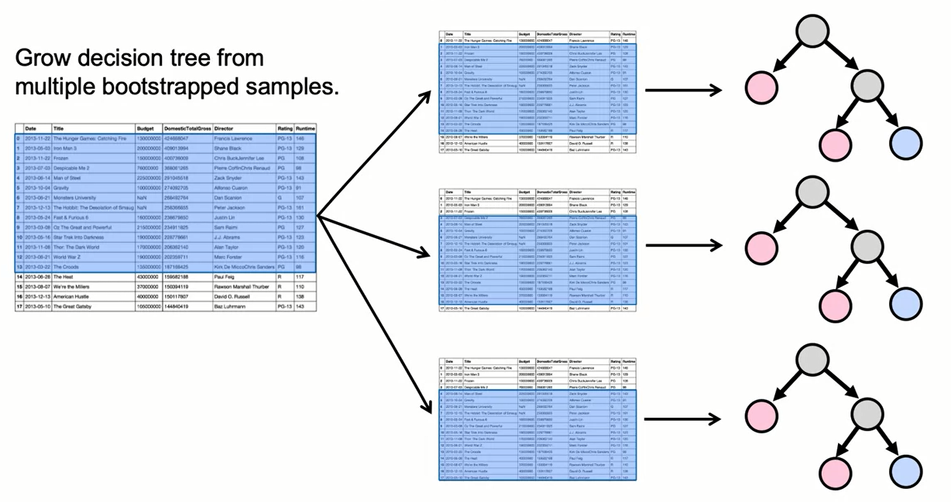
Review of Bagging

Slide 4
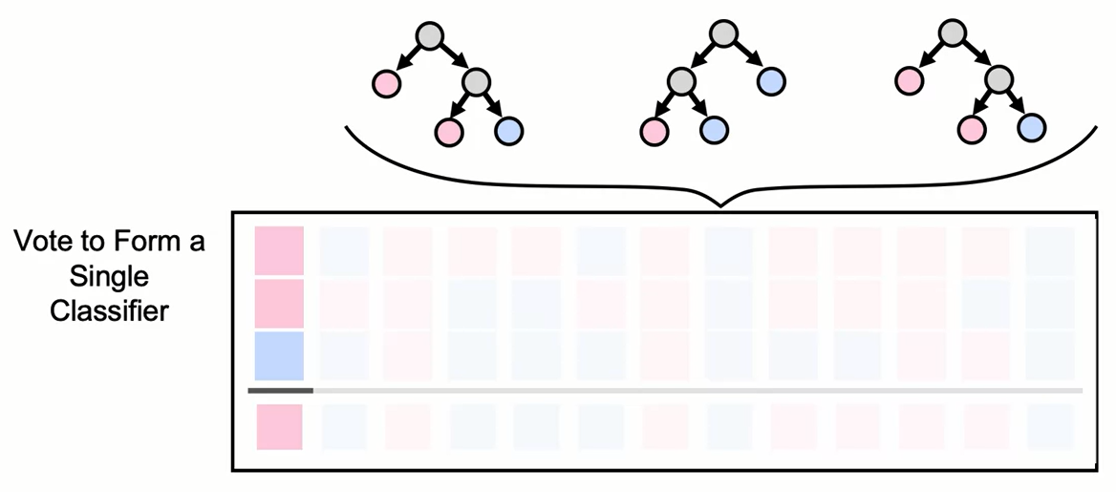
Review of Bagging
Vote on, or average result, from each tree for each data point.

Slide 5
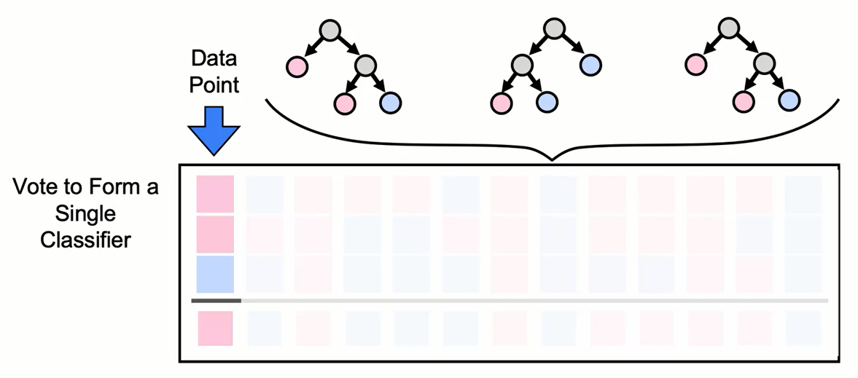
Review of Bagging
Vote on, or average result, from each tree for each data point.

Slide 6
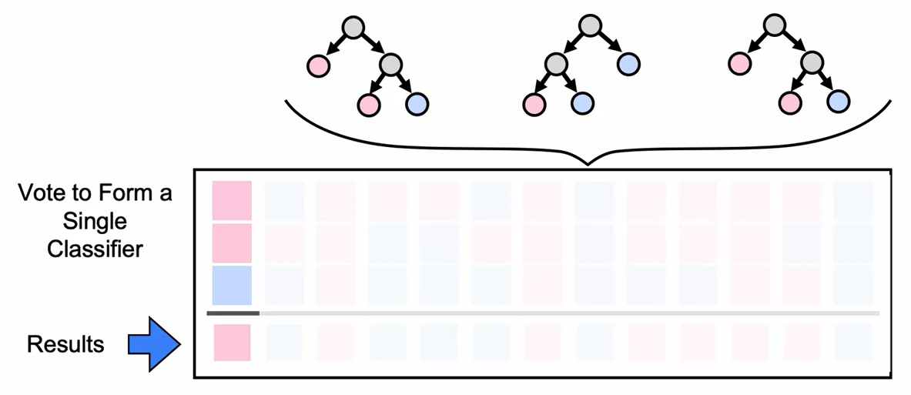
Review of Bagging
Vote on, or average result, from each tree for each data point.

Slide 7
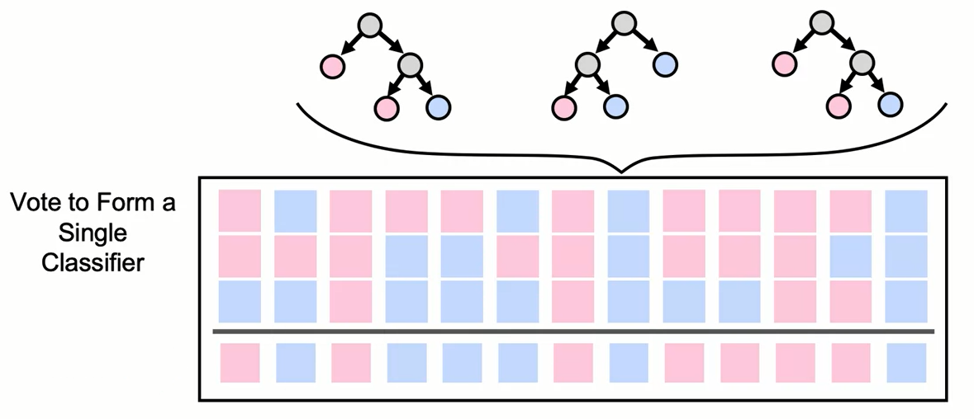
Review of Bagging
Vote on, or average result, from each tree for each data point.

Slide 8
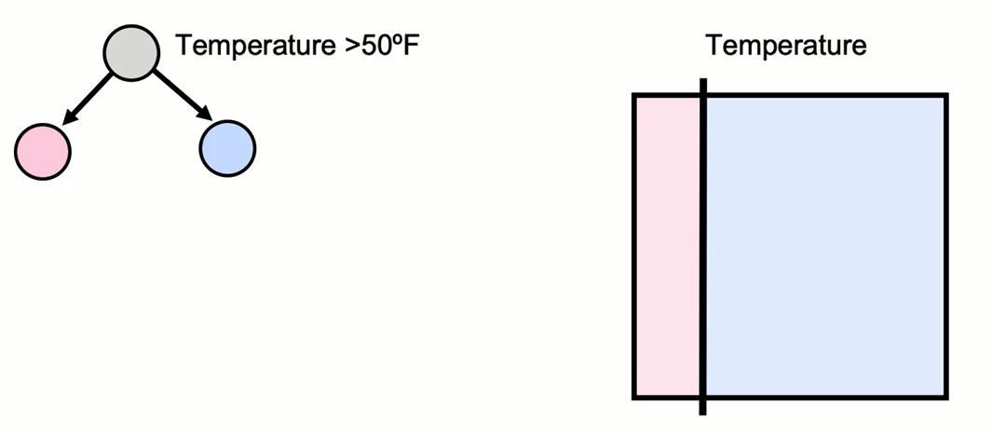
Decision Stump: Boosting Base Learner

Slide 9
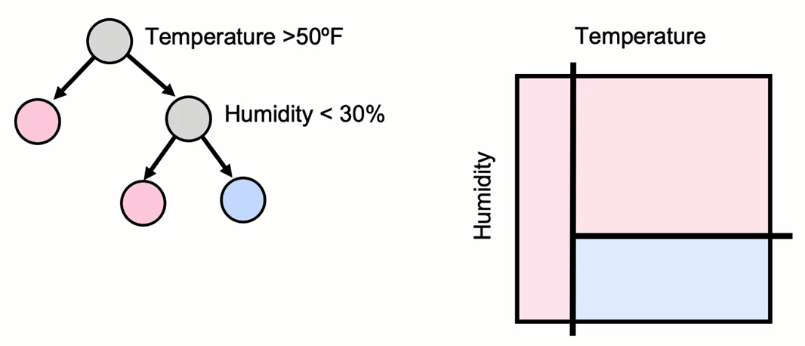
Decision Stump: Boosting Base Learner

Slide 10
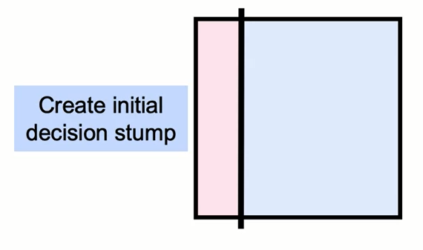
Overview of Boosting

Slide 11
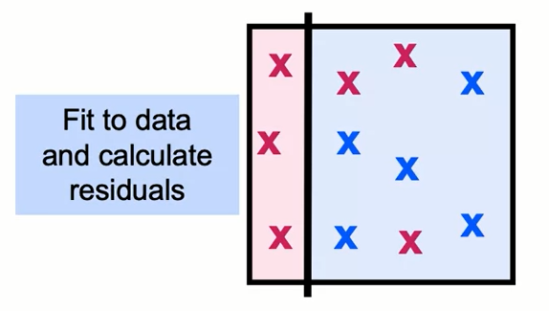
Overview of Boosting

Slide 12
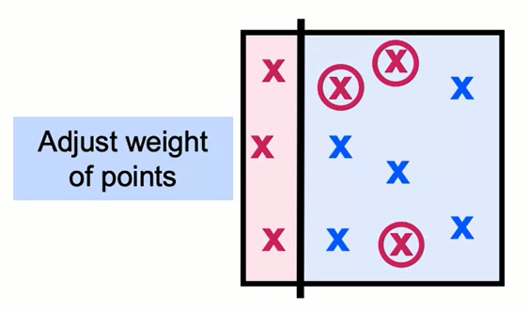
Overview of Boosting

Slide 13
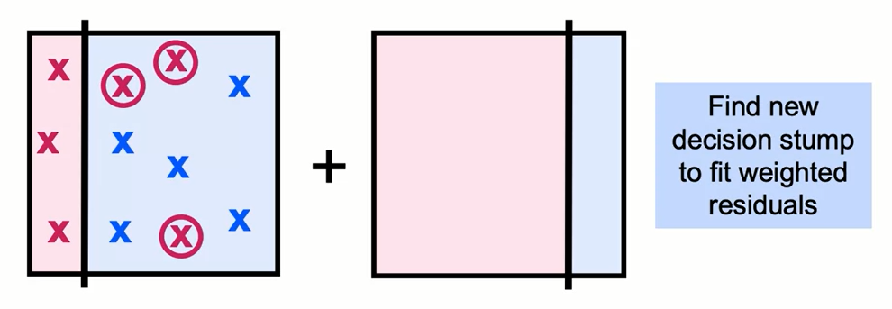
Overview of Boosting

Slide 14
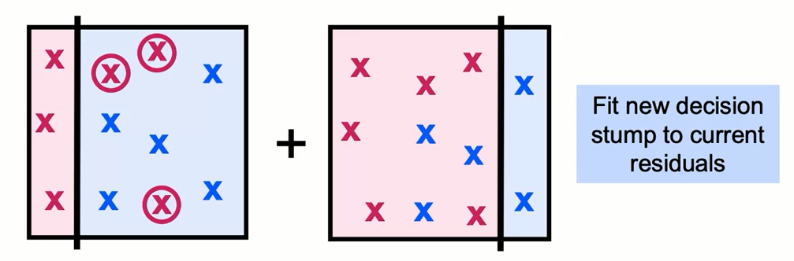
Overview of Boosting

Slide 15
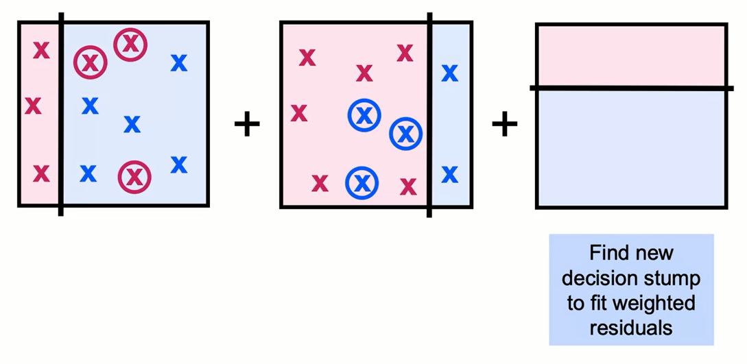
Overview of Boosting

Slide 16
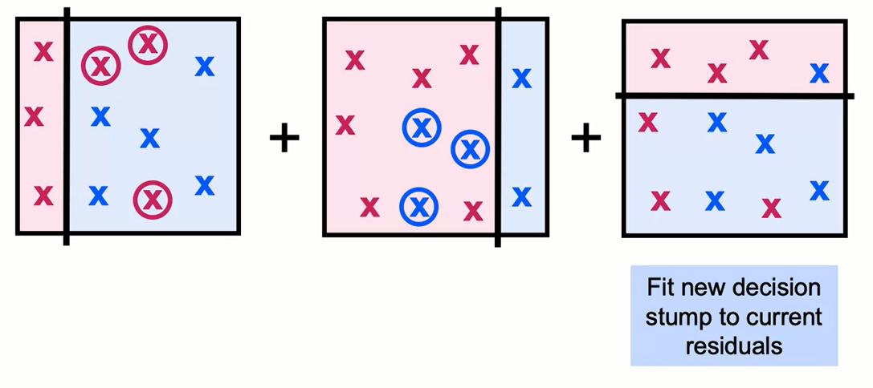
Overview of Boosting

Slide 17
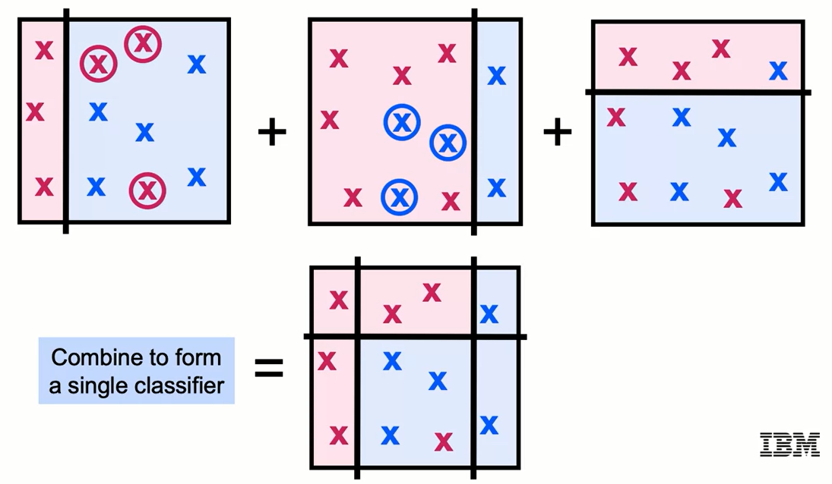
Overview of Boosting

Slide 18
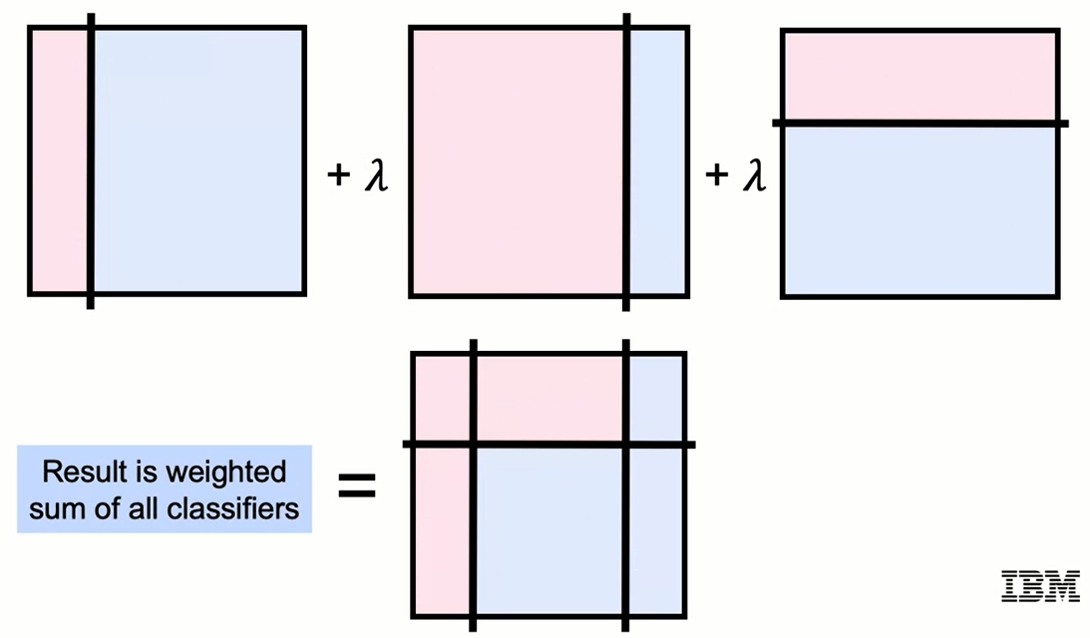
Overview of Boosting

Slide 19
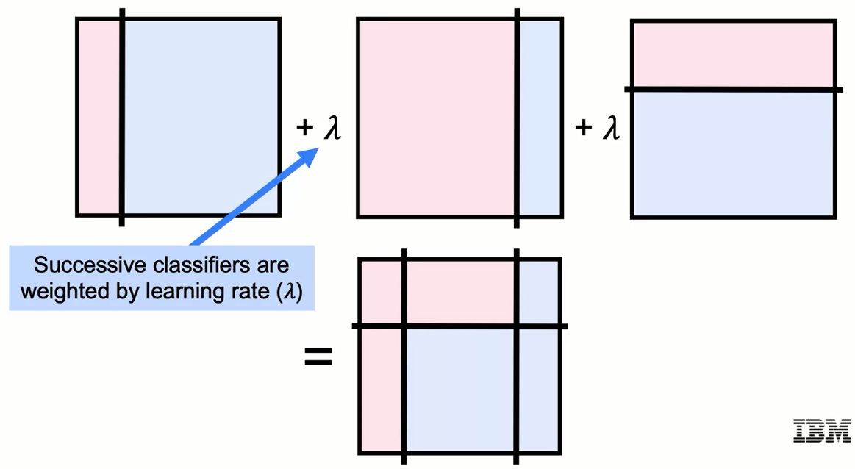
Overview of Boosting

Slide 20
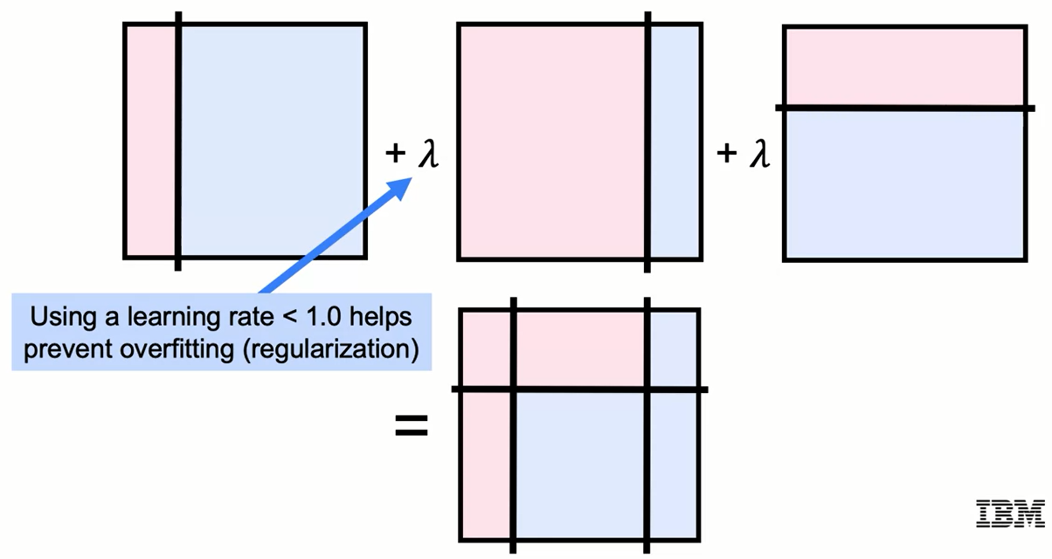
Overview of Boosting

Slide 21
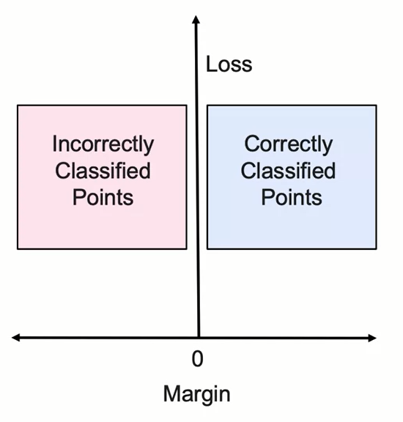
Boosting Specifics
- Boosting utilizes different loss functions.
- At each stage, the margin is determined for each point.
- Margin is positive for correctly classified points and negative for misclassifications.
- Value of loss function is calculated from margin.

Slide 22
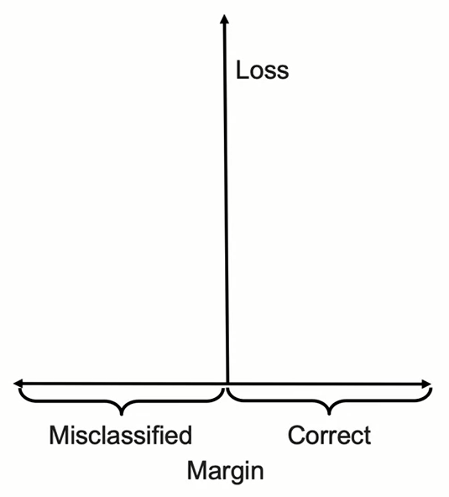
0 - 1 Loss Function
- The 0 – 1 Loss multiplies misclassified points by 1.

Slide 23
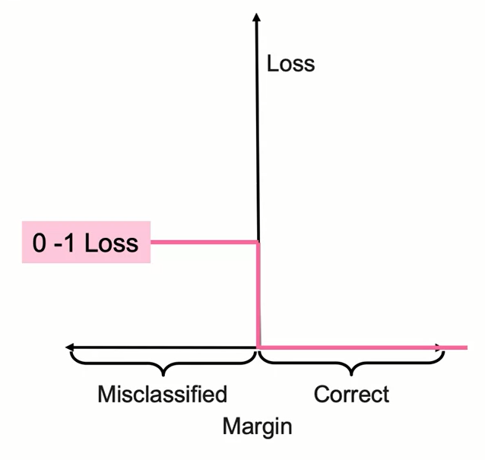
0 - 1 Loss Function
- The 0 – 1 Loss multiplies misclassified points by 1.
- Correctly classified points are ignored.
- Theoretical "ideal" loss function.
- Difficult to optimize — non-smooth and non-convex.

Slide 24
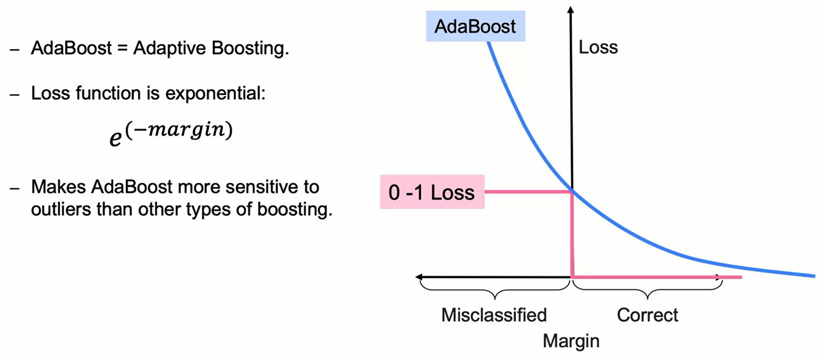
AdaBoost Loss Function

Slide 25
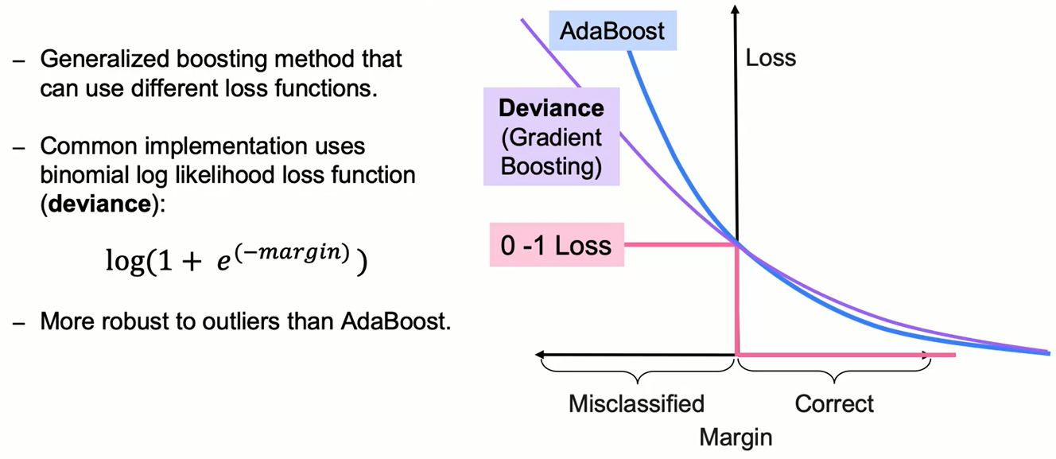
Gradient Boosting Loss Function

Slide 26
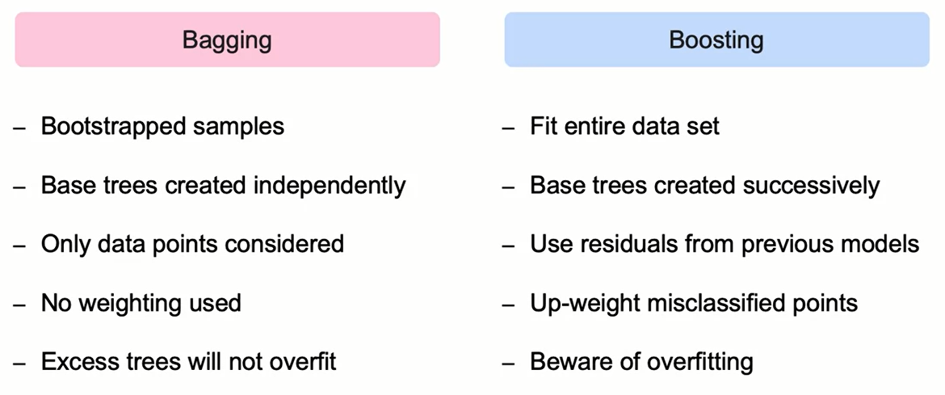
Bagging vs Boosting

Slide 27
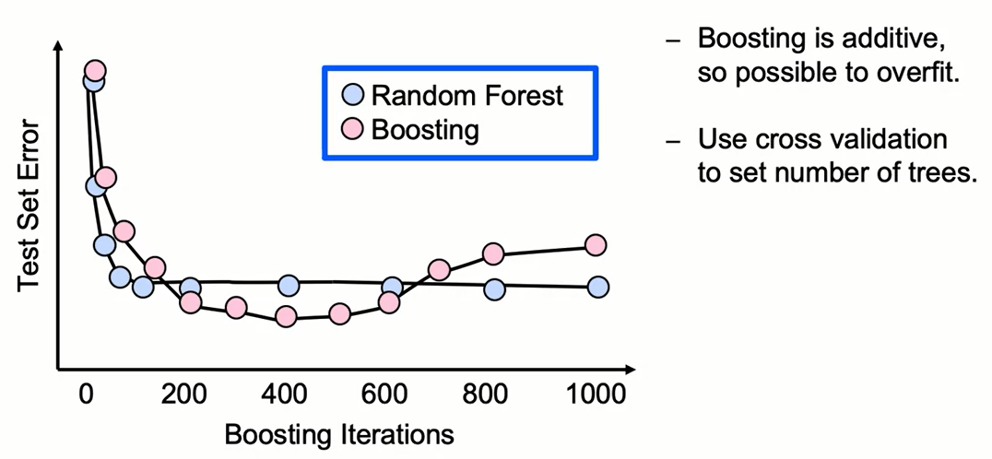
Tuning a Gradient Boosted Model

Slide 28
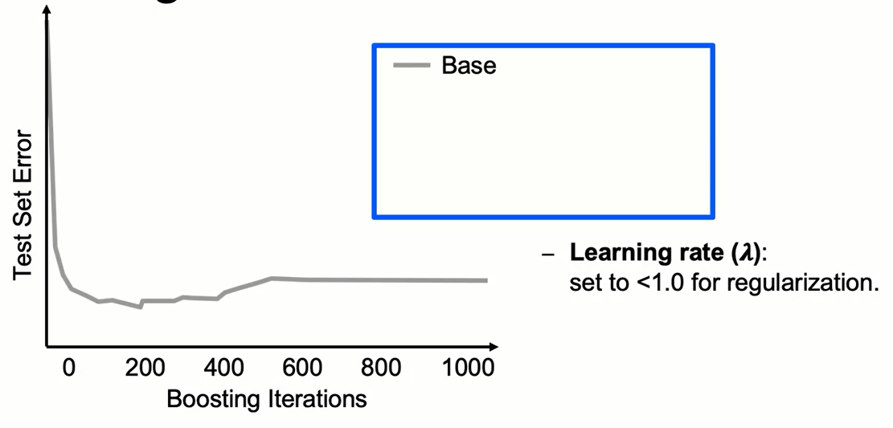
Tuning a Gradient Boosted Model

Slide 29
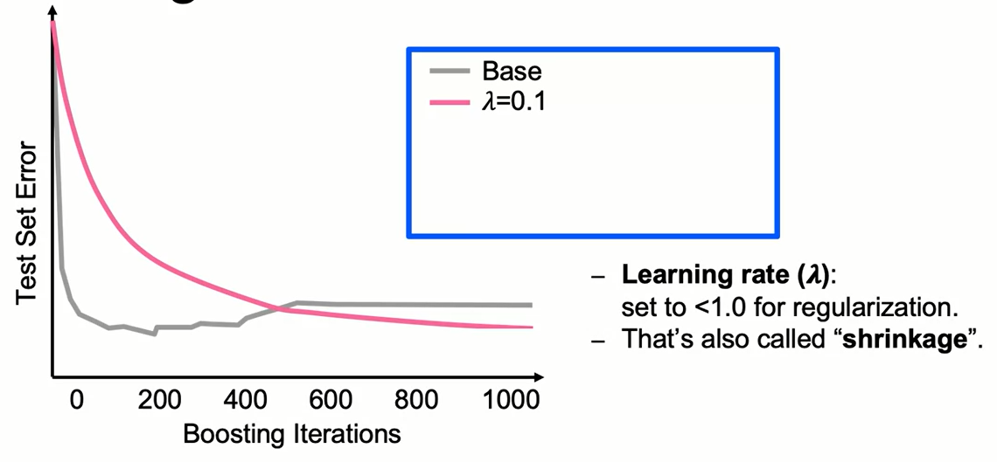
Tuning a Gradient Boosted Model

Slide 30
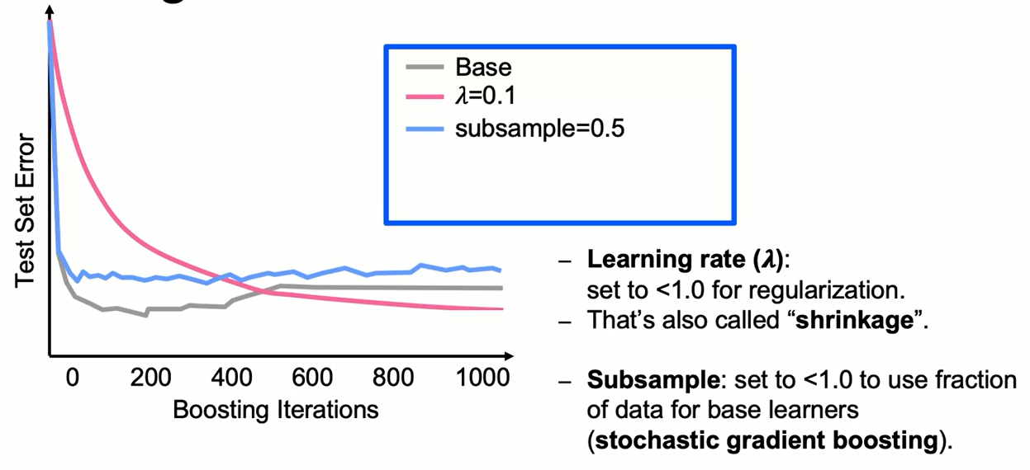
Tuning a Gradient Boosted Model

Slide 31
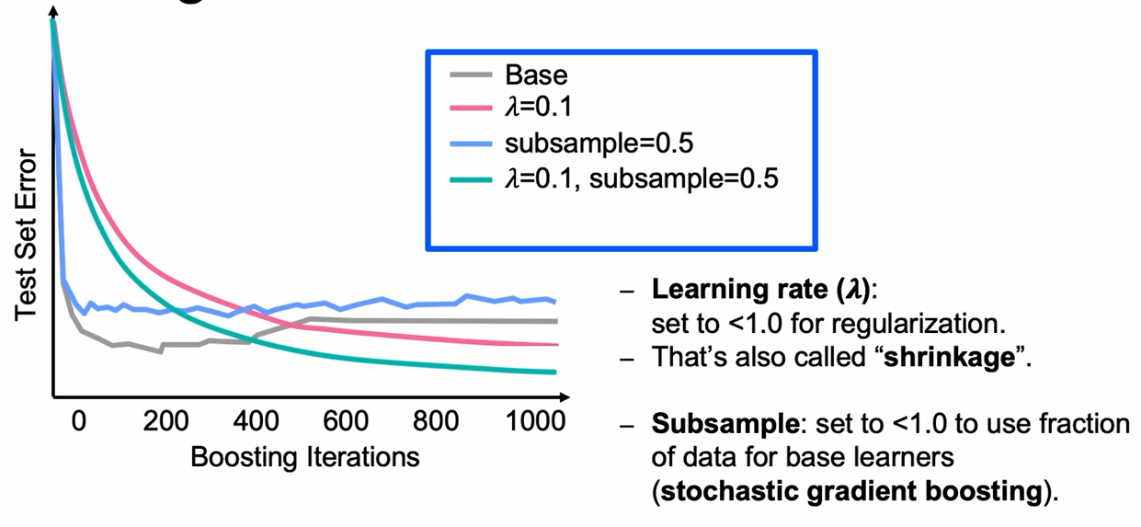
Tuning a Gradient Boosted Model

Slide 32
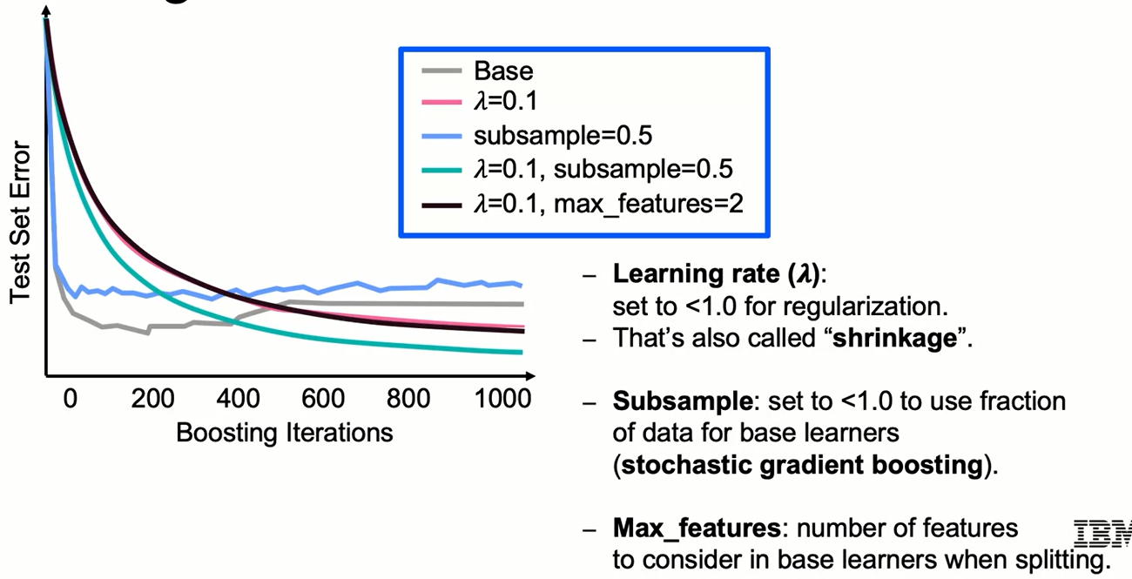
Tuning a Gradient Boosted Model

Slide 33
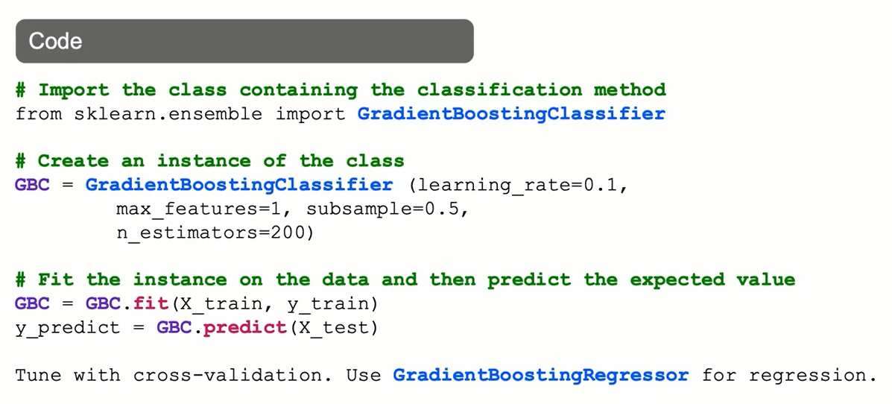
GradientBoostingClassifier: The Syntax

Slide 34
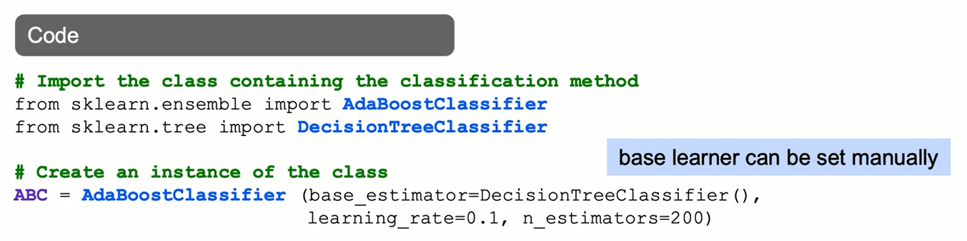
AdaBoostClassifier: The Syntax

Slide 35
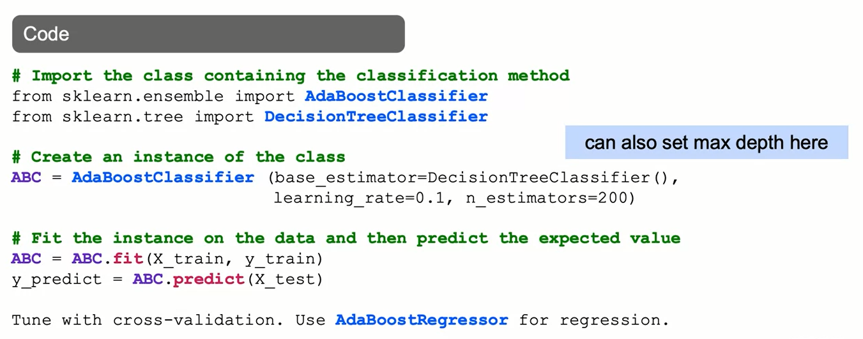
AdaBoostClassifier: The Syntax

Slide 36
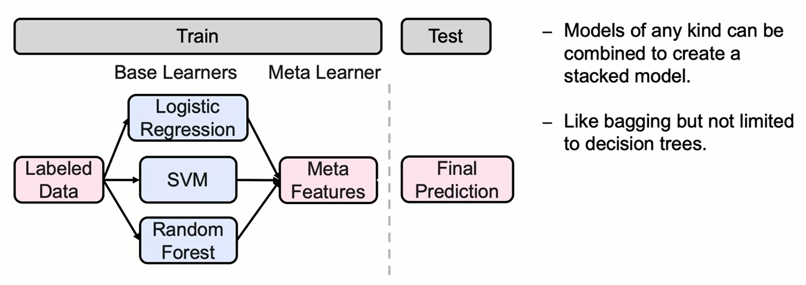
Stacking: Combining Classifiers

Slide 37
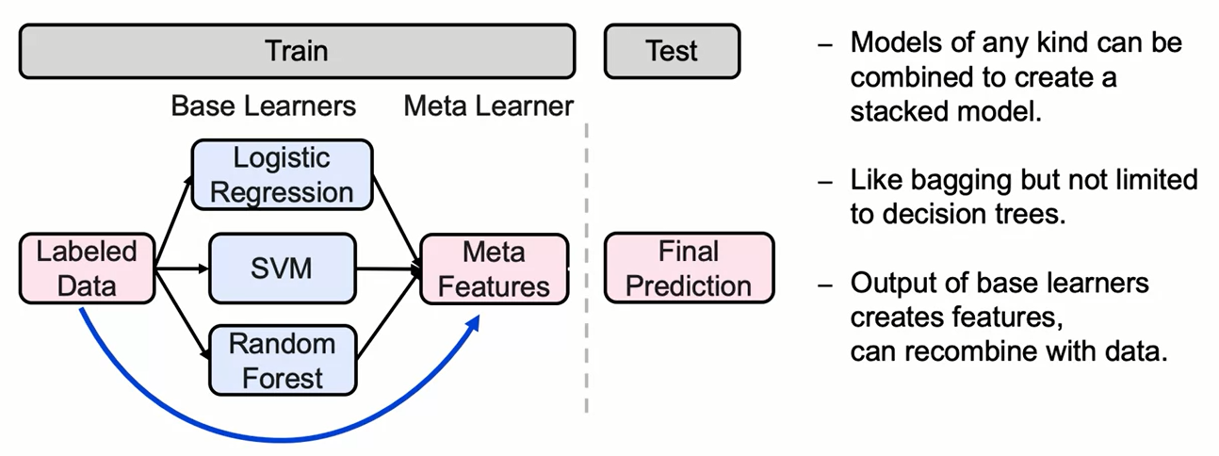
Stacking: Combining Classifier

Slide 38
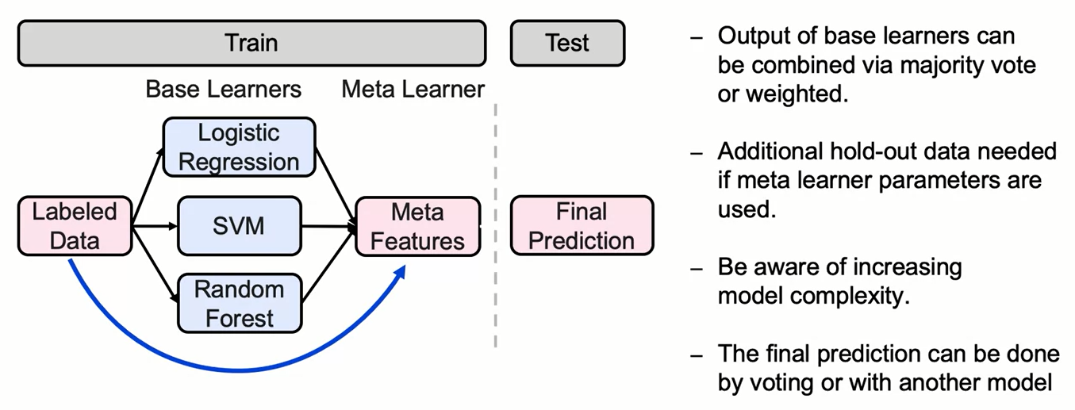
Stacking: Combining Classifiers

Slide 39
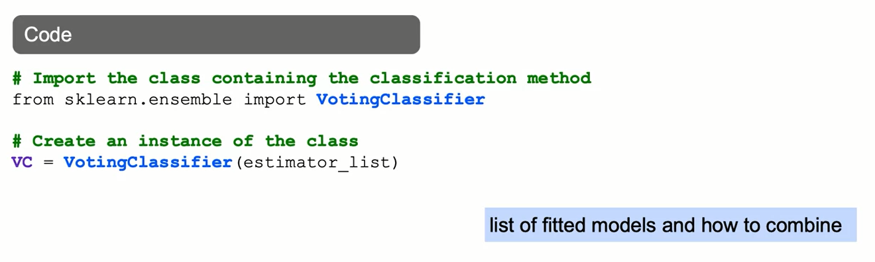
VotingClassifier: The Syntax

Slide 40
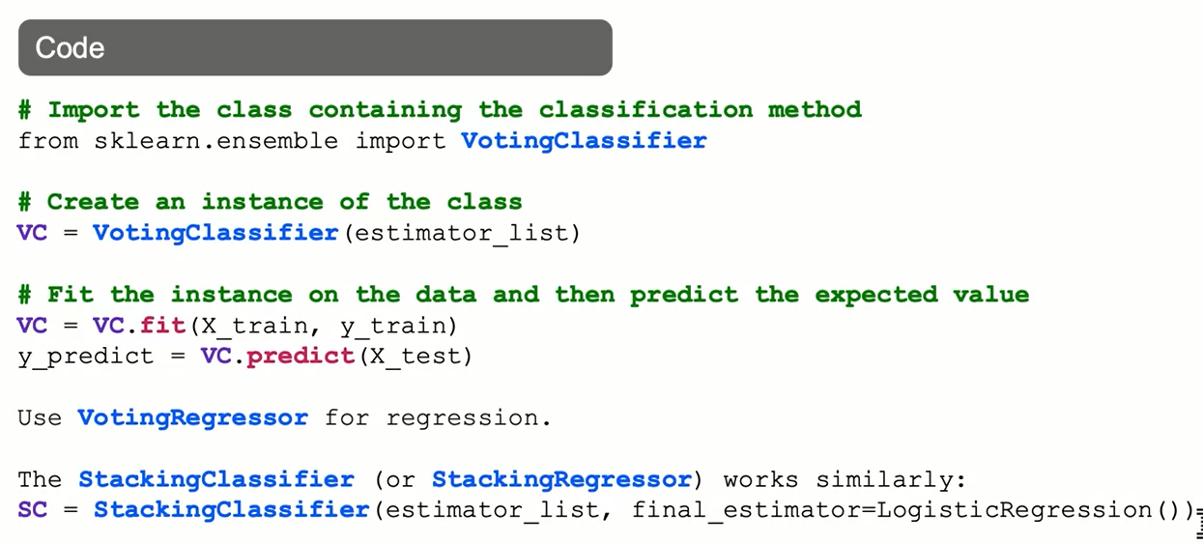
VotingClassifier: The Syntax

Slide 41
Summary
Boosting
Boosting methods are additive in the sense that they sequentially retrain decision trees using the observations with the highest residuals on the previous tree. To do so, observations with a high residual are assigned a higher weight.
Gradient Boosting
The main loss functions for boosting algorithms are:
0-1 loss function, which ignores observations that were correctly classified. The shape of this loss function makes it difficult to optimize.
Adaptive boosting loss function, which has an exponential nature. The shape of this function is more sensitive to outliers.
Gradient boosting loss function. The most common gradient boosting implementation uses a binomial log-likelihood loss function called deviance. It tends to be more robust to outliers than AdaBoost.

Slide 42
Summary
Boosting
The additive nature of gradient boosting makes it prone to overfitting. This can be addressed using cross validation or fine tuning the number of boosting iterations. Other hyperparameters to fine tune are:
learning rate (shrinkage)
subsample
number of features.
Stacking
Stacking is an ensemble method that combines any type of model by combining the predicted probabilities of classes. In that sense, it is a generalized case of bagging. The two most common ways to combine the predicted probabilities in stacking are: using a majority vote or using weights for each predicted probability.

Slide 43
Learning Recap
In this section, we discussed:
- The Boosting approach to combining models
- Types of Boosting models: Gradient Boosting, AdaBoost
- Boosting loss functions
- Combining heterogeneous classifiers

